Slide 1




GIS to BIM using Dynamo
How to load 3D GIS data into Dynamo?
How to do location analysis in Dynamo/Revit?
Maarten Vroegindeweij
3BM (Labs)/ Domera
Notes:
-Welcome
-My

Slide 2

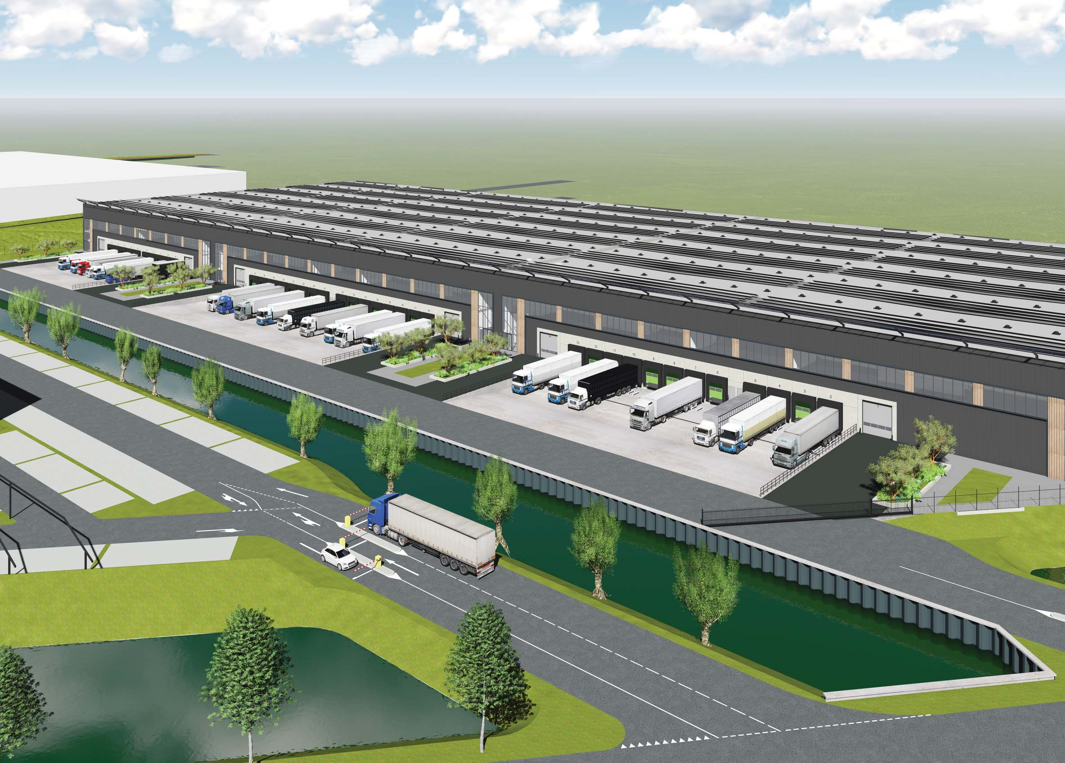

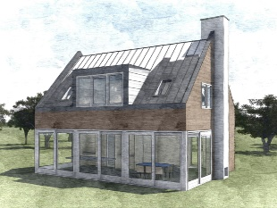

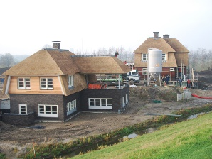

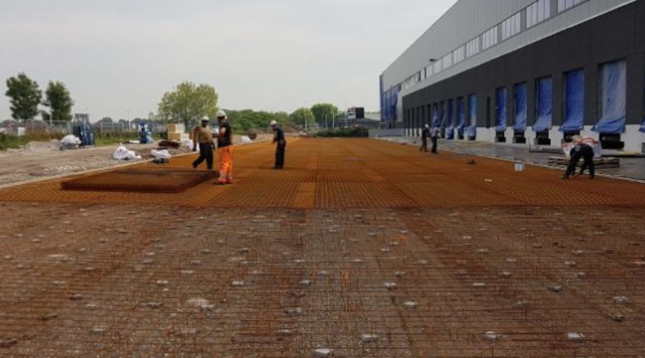
About 3BM
Consulting engineers since 2009
www.3bm.co.nl
Structural-, Wood Framing, Façade and Prefab Engineering, Monuments
Notes:
30 seconds:
-Zwijndrecht 6 persons.
3BM is a modern business model. A cooperation with a hybrid model. Employed and self-employed people working together.
Revit since 2009 and Dynamo sincs 2015
Small industry & housing sector.
We take care of the structural design of the buildings. Another department is doing the Prefab Detail Engineering including architectural 3D-BIM-models and drawings with a high detaillevel.
Our project have a wide variety. We did some distribution centers of 30.000 m2, but also a lot of individual houses for private persons. And a lot of renovation projects in the old city of Dordrecht where I live myself.

Slide 3
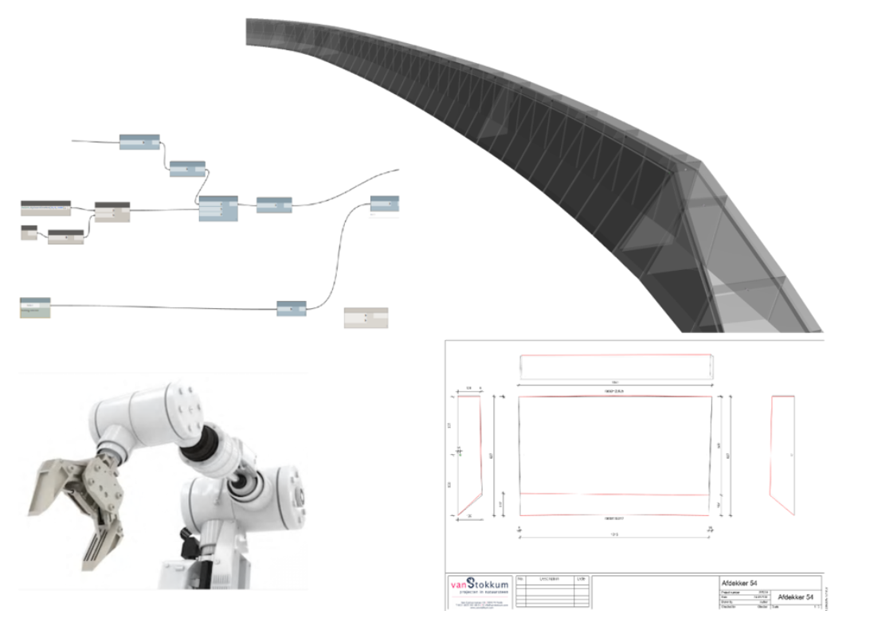
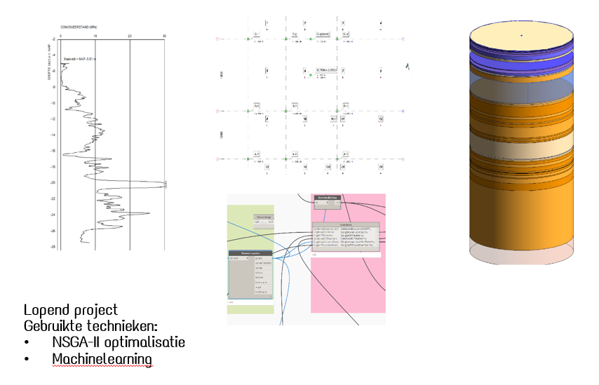
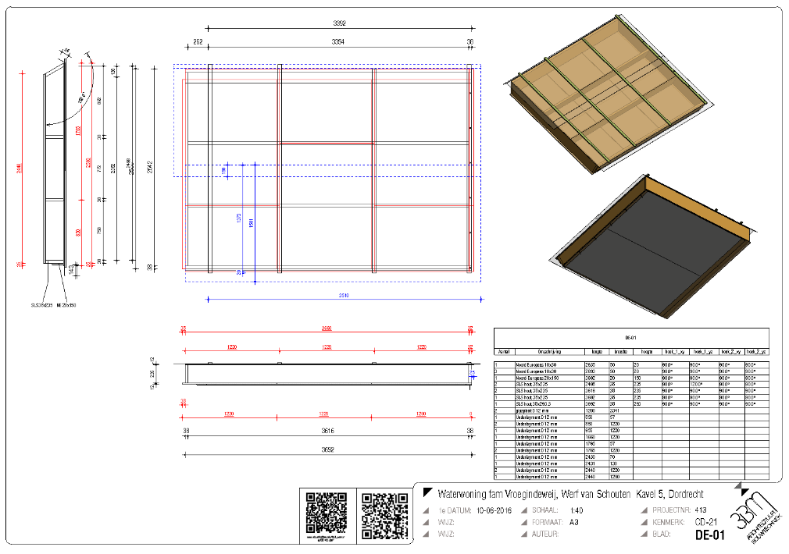
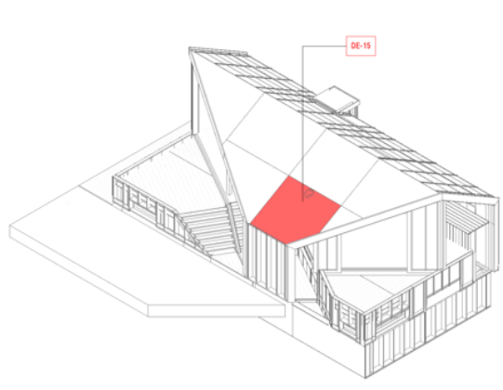
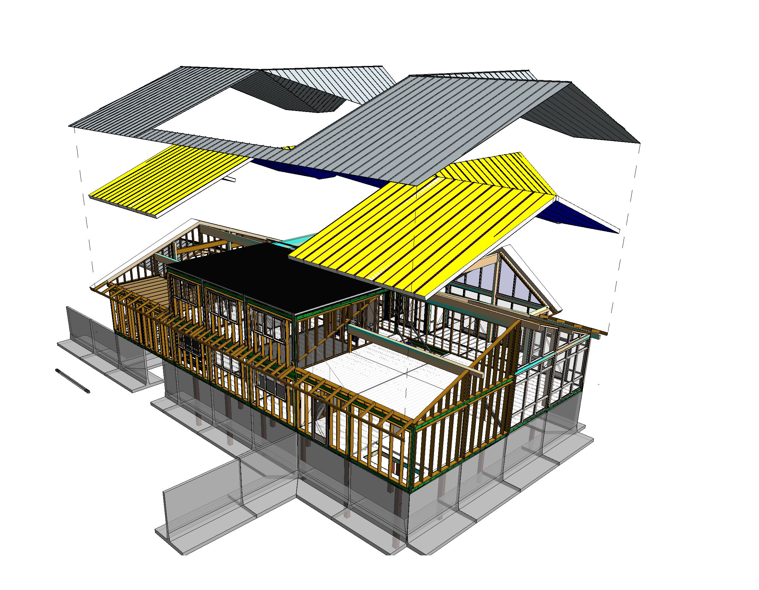
About 3BM Labs
Digital Fabrication/Drawing Automation
Software Development
Computational BIM
Optimisation
Dynamo Consultancy
Notes:
2 minutes
3BM Labs is a startup within 3BM fully focused on computation design and automation of workflows and products for our clients.
Within 3BM Labs we act as consultants for our clients(mainly contractors and fabricators.
We automate 3D detailengineering, data handling, drawing automation and that sort of stuff for our clients.

Slide 4
To learn
GIS/Rasterdata/Vectordata
Where to find relevant data for The Netherlands?
How to load this data into Dynamo?
How to combine vector and rasterdata
Notes:
That’s brings me to what we are going to learn today?

Slide 5
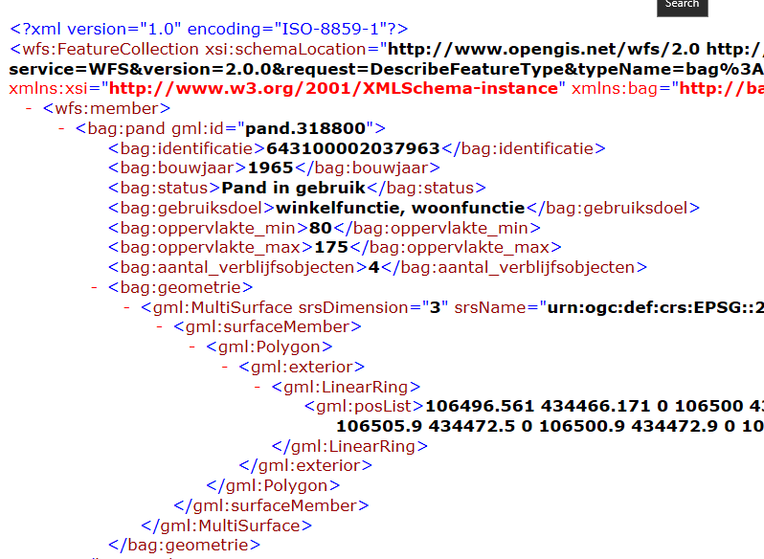


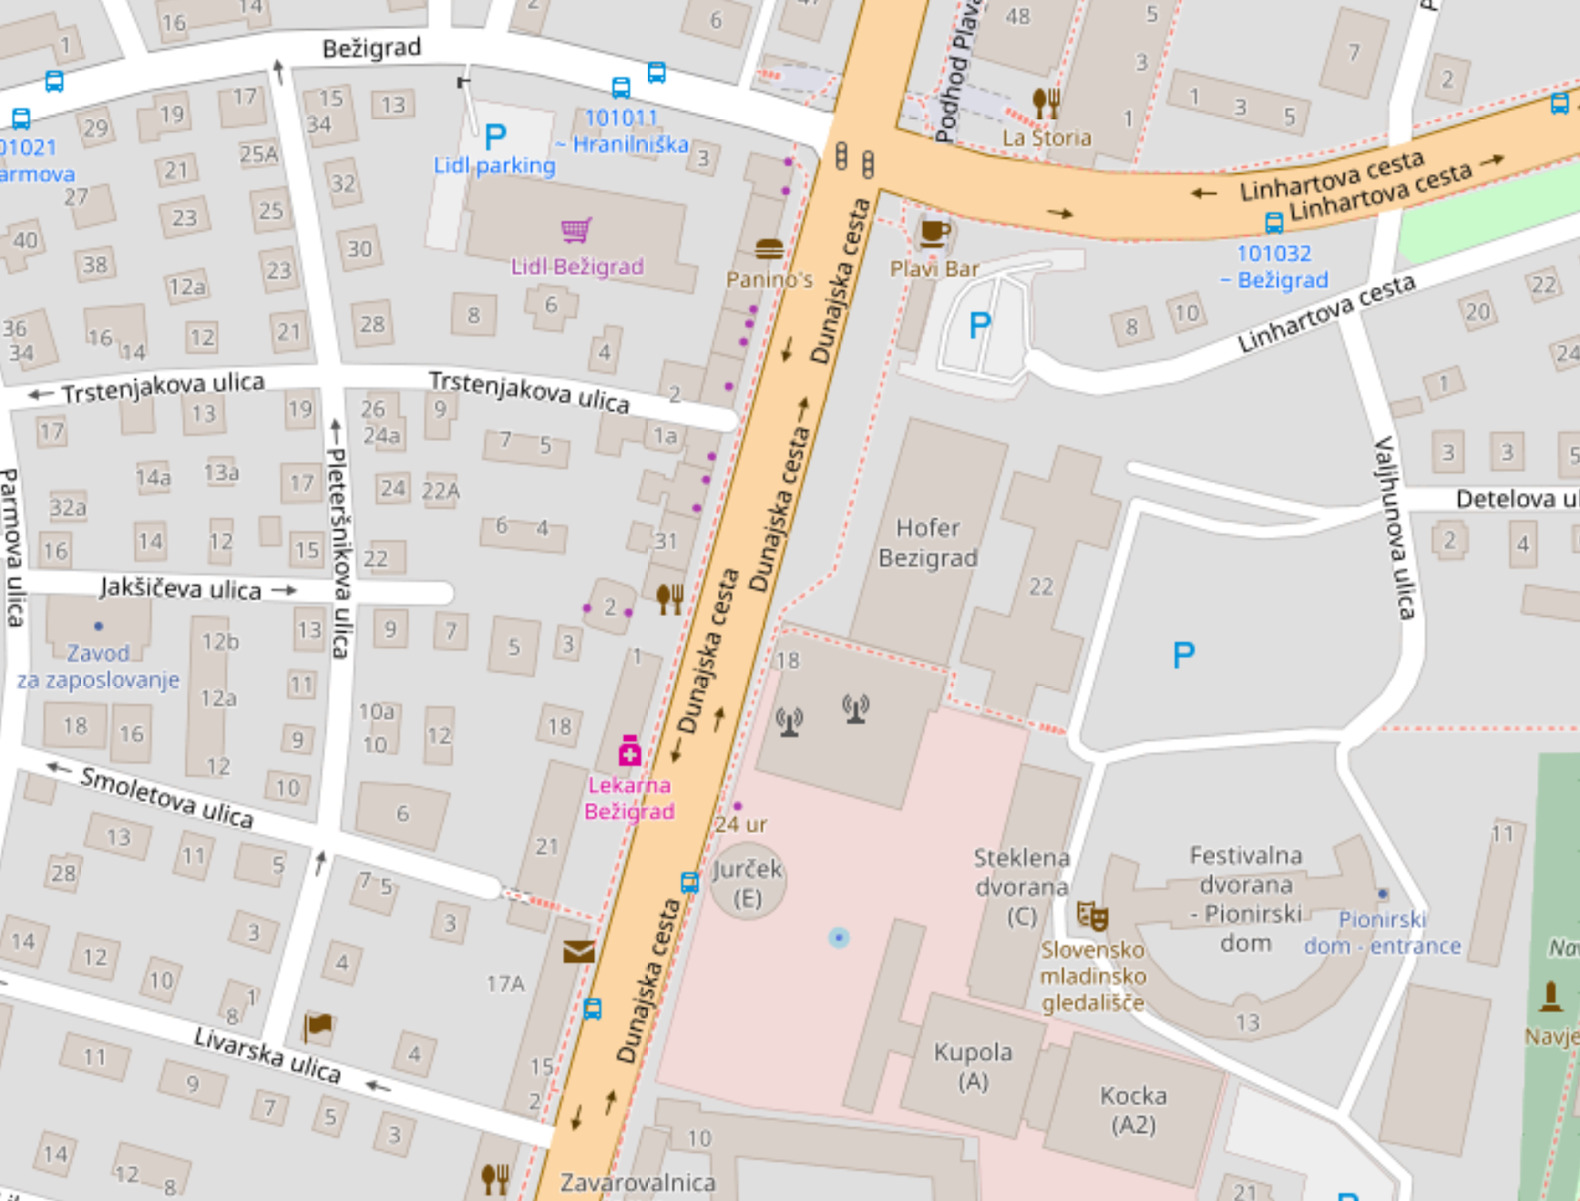
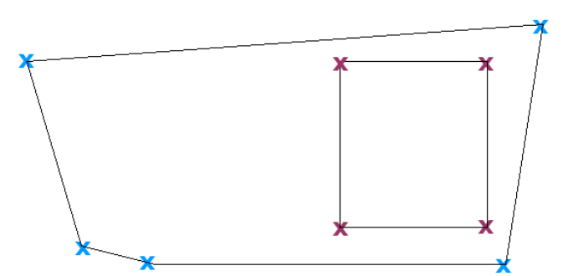
Contents of this presentation
1. Intro GIS
2. Rasterdata
Location Analysis using Dynamo
3. Vectordata
Vectordata / 3D BAG, AHN3, BGT
4. Conclusion & more information
PDOK
Notes:
This afternoon I would like
Hands up for architects, engineers, manager
The idea is that after this classs you can use Dynamo yourselve to load and analyse GIS-data into Revit.

Slide 6
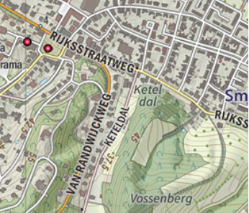
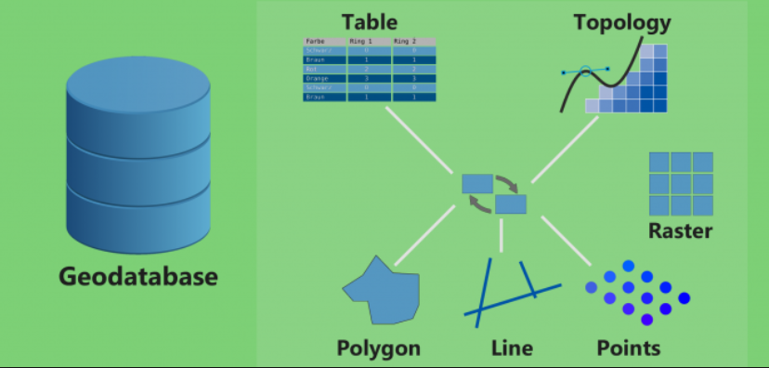
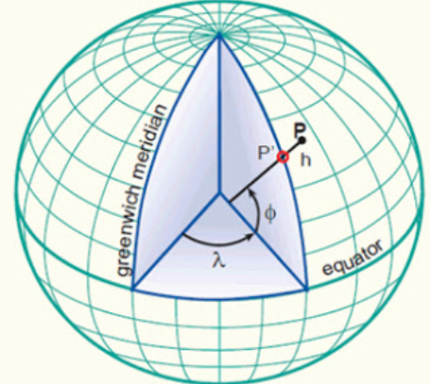
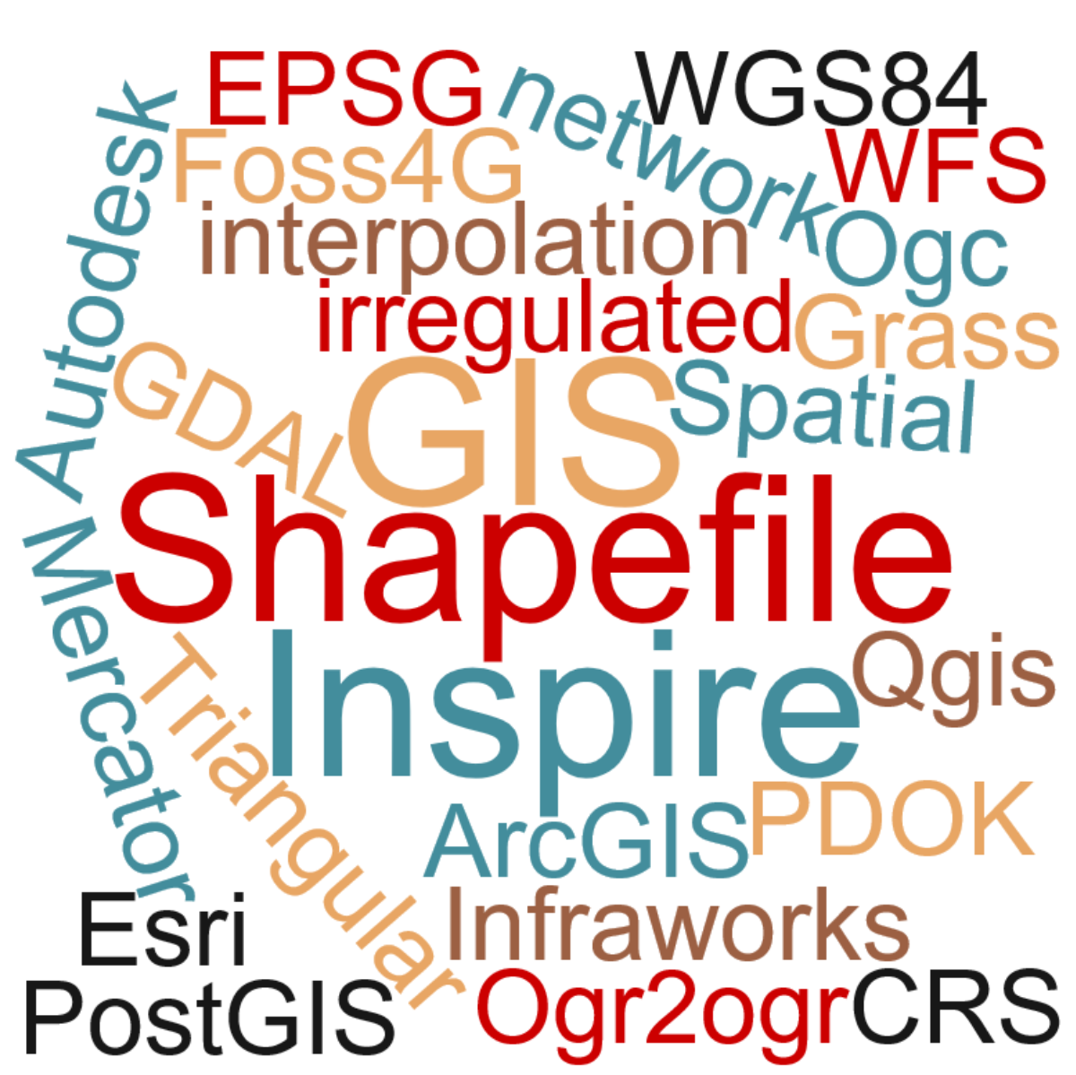
1. Intro GIS
Maps
Webservers
Geo Databases
Coordinate Reference Systems
Notes:
The things we see from GIS are

Slide 7
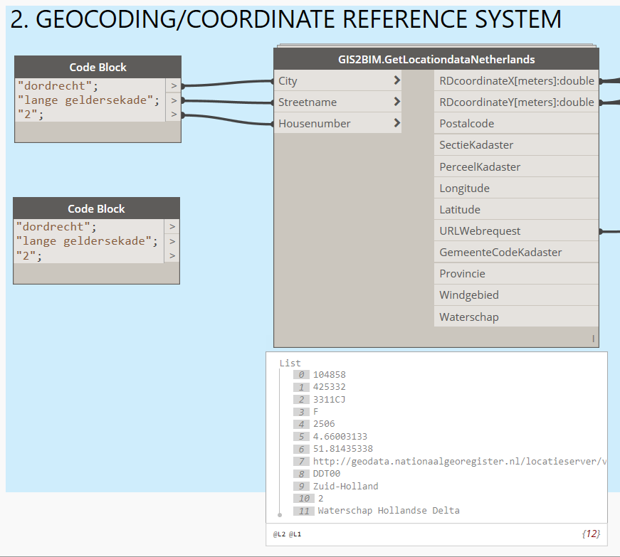
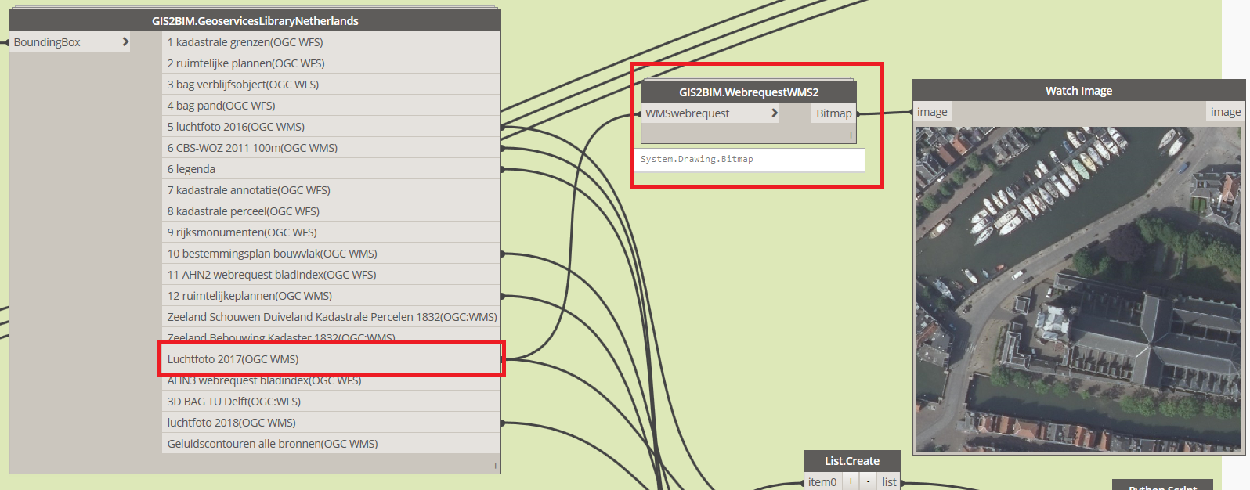
2. Rasterdata
Geocoding/CRS
Web Map Service(WMS)
Web Map Tile Service(WMTS)
Live Dynamo
Notes:
So we will have a look at the different ways of

Slide 8
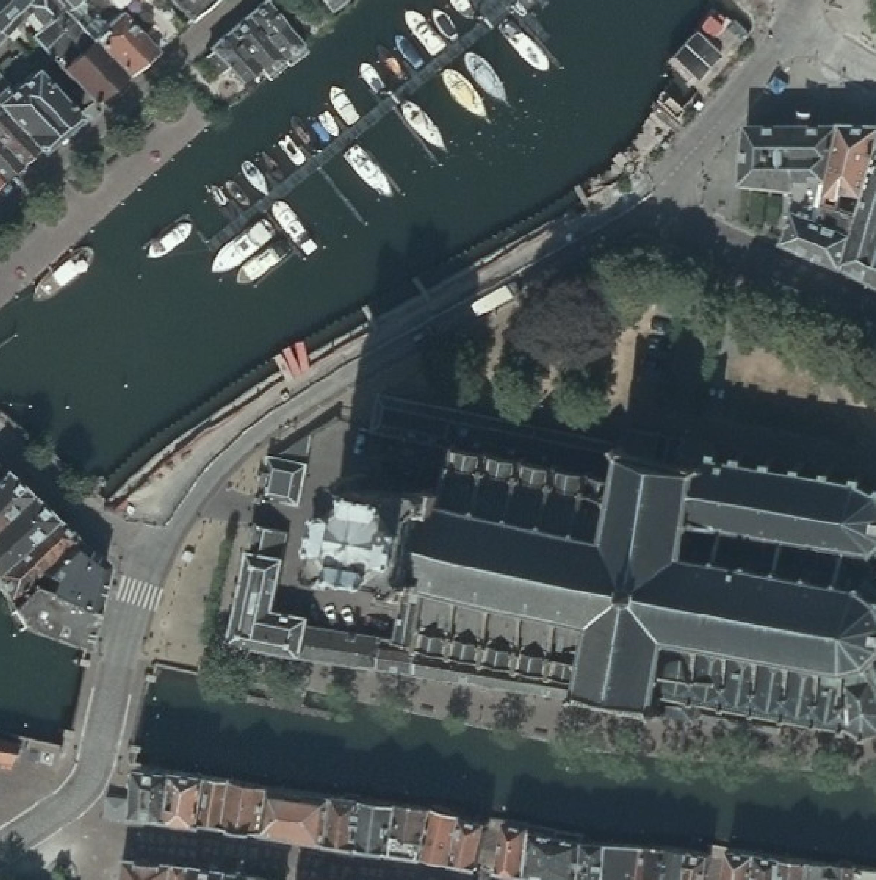
2. Web Map Service(WMS)
Request&Response
http://geodata.nationaalgeoregister.nl/
luchtfoto/rgb/wms?
&request=GetMap
&VERSION=1.3.0
&STYLES=default
&layers=2018_ortho25
&bbox=104783,425257,104933,425407
&width=3000
&height=3000
&format=image/png
&crs=EPSG:28992

Slide 9
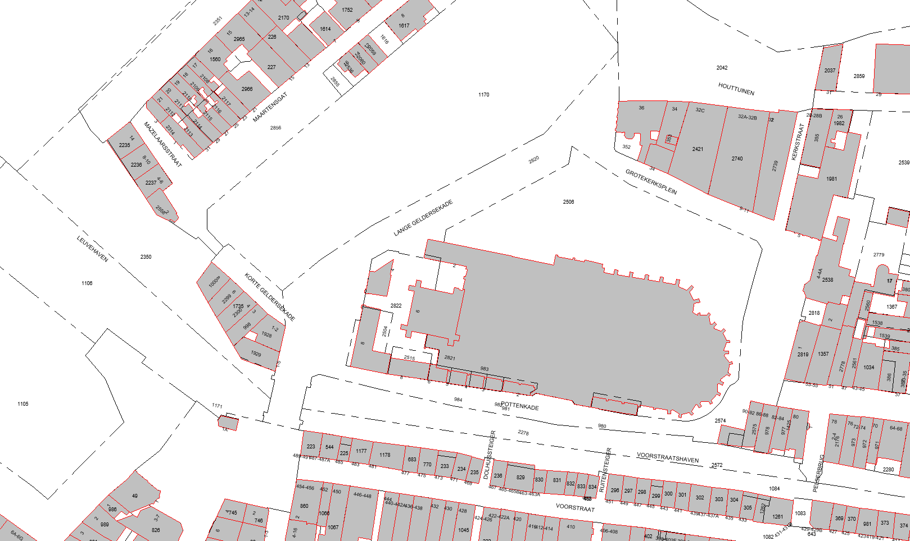
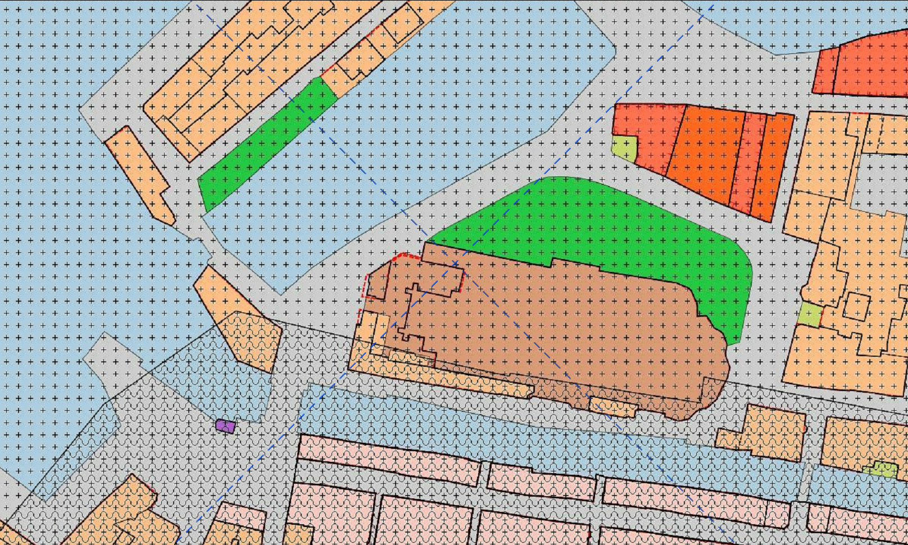
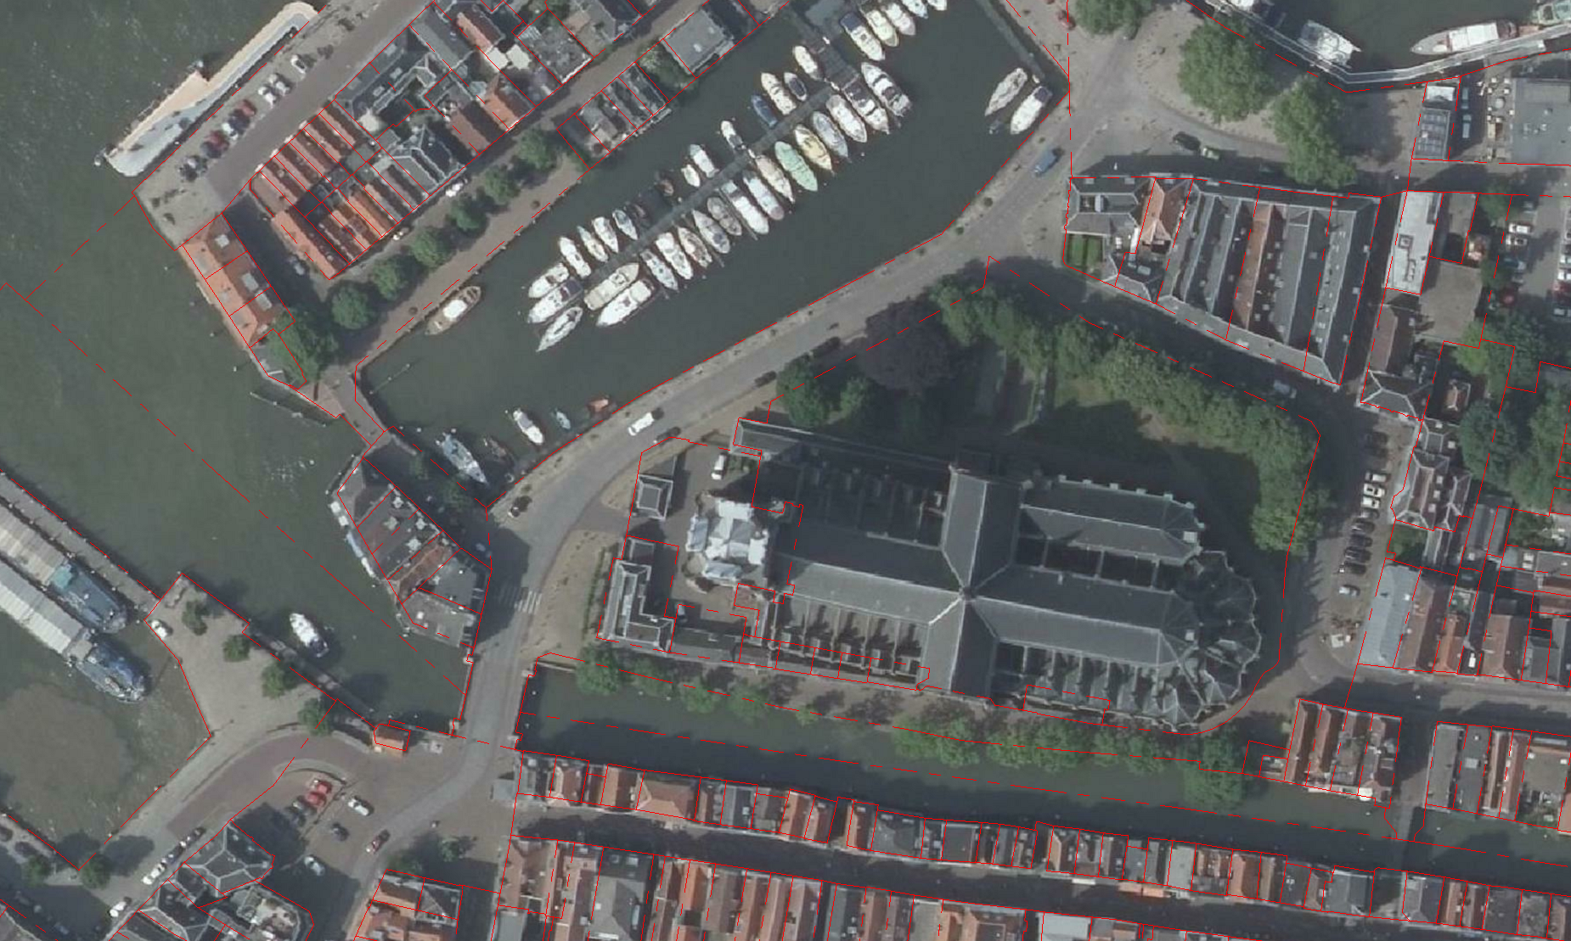
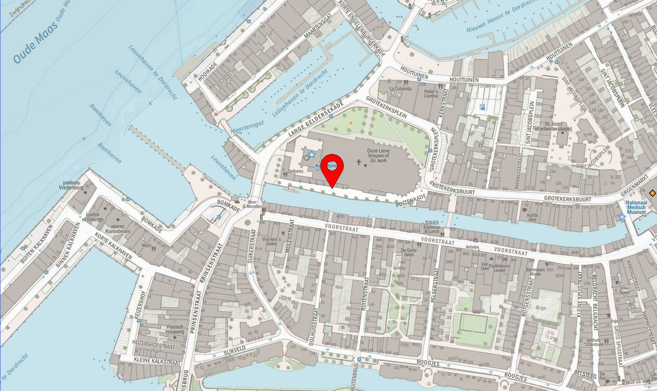
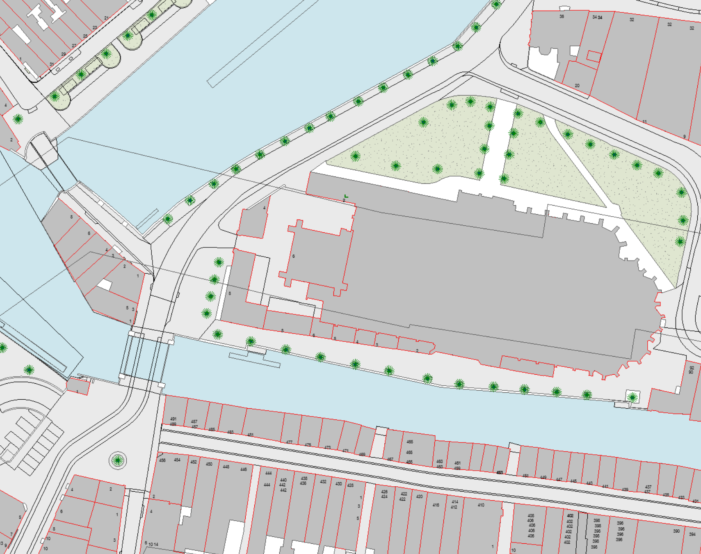
2. Location Analysis
Use a lot of WMS, WFS, WMTS services together to create a location analysis report inside Revit
-OPEN IN REVIT-

Slide 10
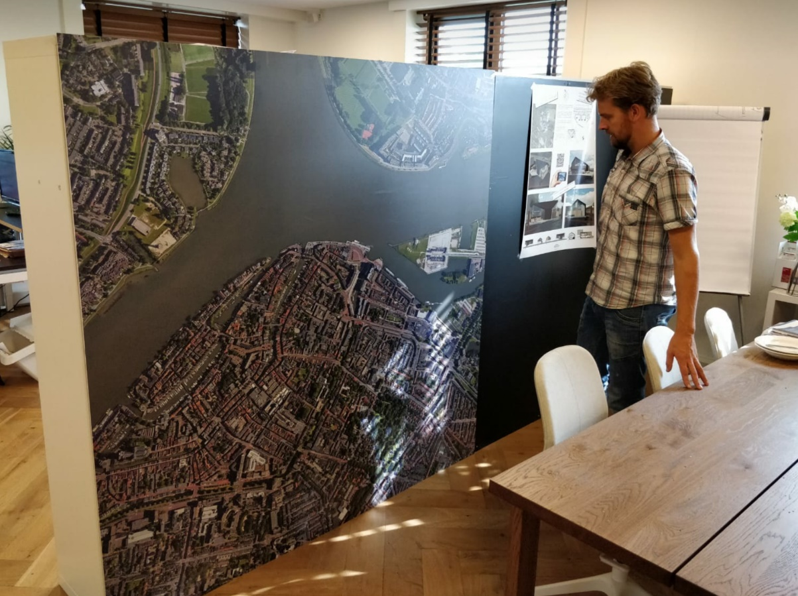
2. Other applications ;-)

Slide 11
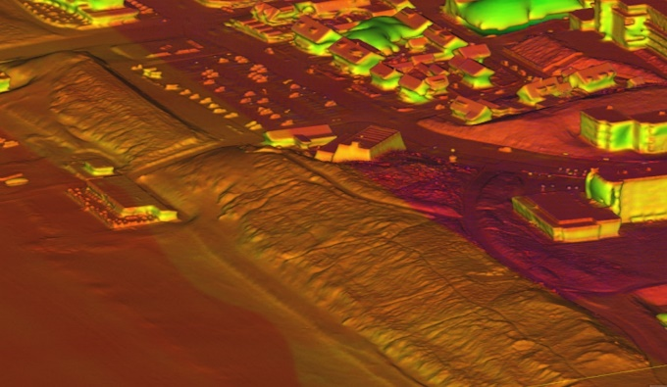
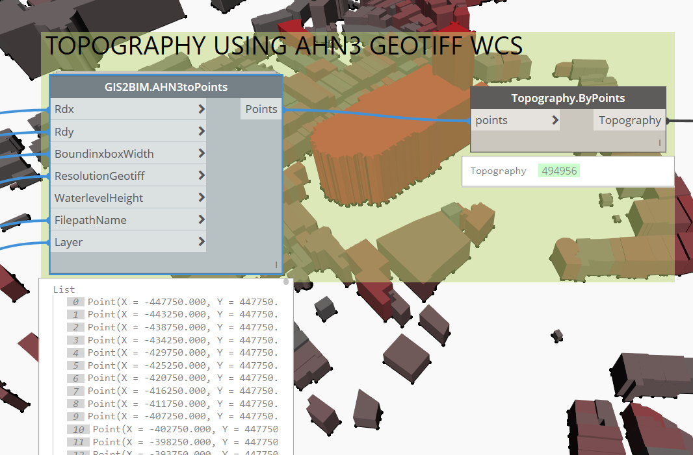
3. Vectordata: AHN3 WCS GEOTIFF
AHN3 pointcloud data
Geotiff
Notes:
So we will have a look at the different ways of

Slide 12
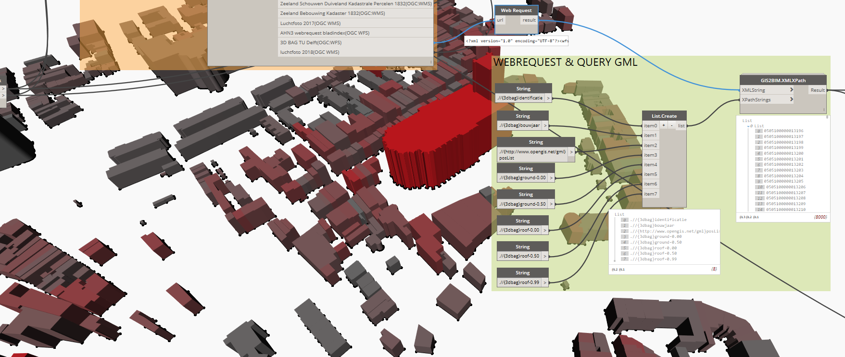
3. Vectordata: 3D BAG
3D BAG: server TU Delft: http://3dbag.bk.tudelft.nl/
Notes:
So we will have a look at the different ways of

Slide 13
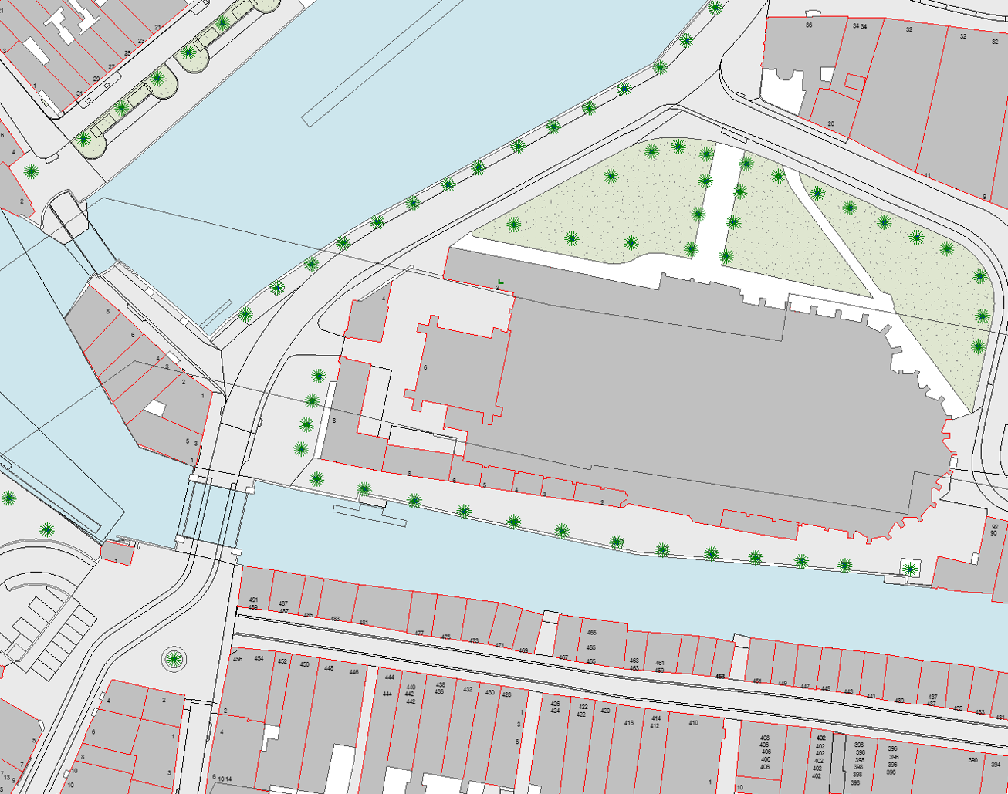
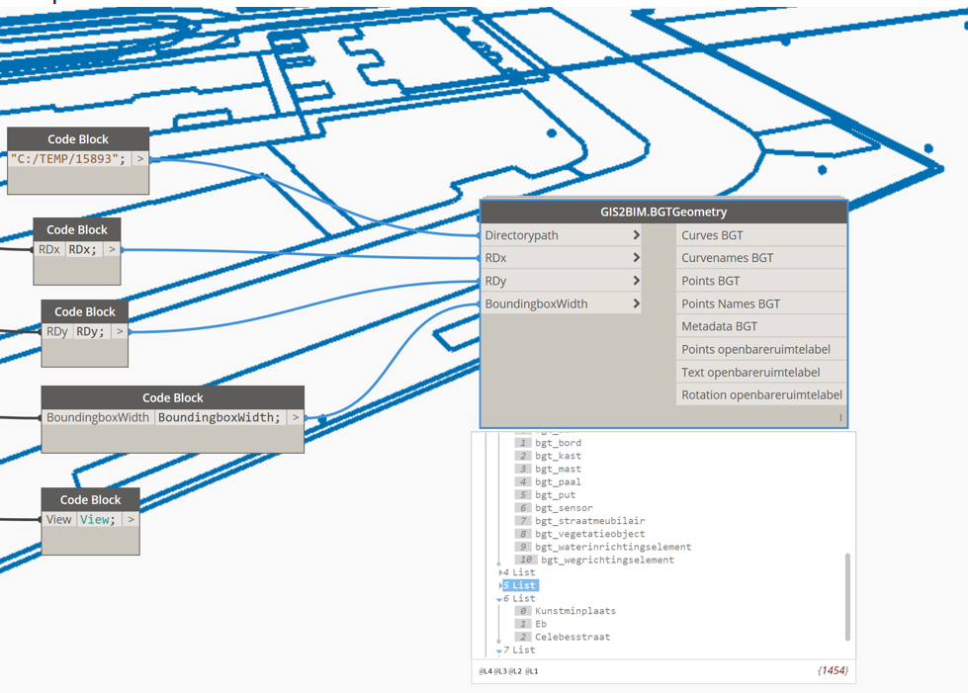
3. Vectordata: BGT
WFS(not available anymore)
Download (slow)
Notes:
So we will have a look at the different ways of

Slide 14
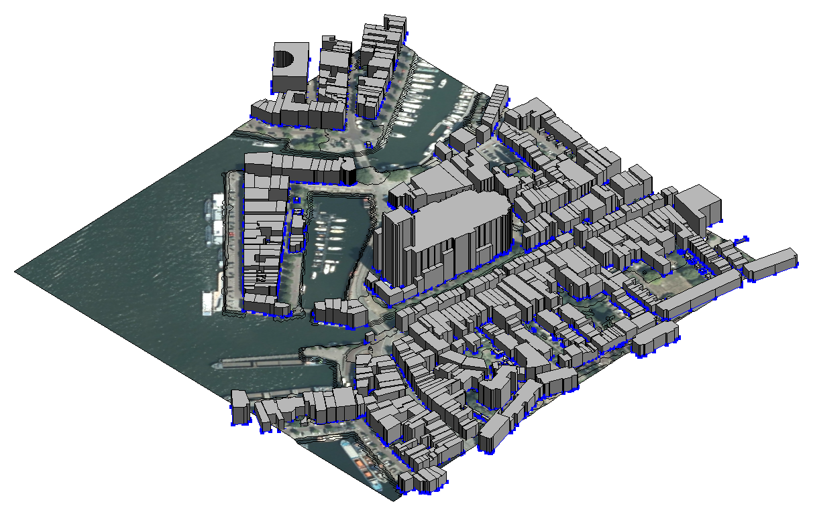
3. Combine AHN3 & 3D BAG & WMS & BGT
Live Dynamo
Notes:
So we will have a look at the different ways of

Slide 15
4. To remember
Geocoding
Raster/Vector
WMS: Web Map Service(Raster)
WMTS/TMS: Web Map Tile Service(Raster)
WFS: Web Feature Service(Vector)
ARCGIS REST API Raster/Vectordata via ArcGIS API
BAG: (Buildings in The Netherlands)

Slide 16
4. To write down: Dynamo Packages
Dynamo Packages
ELK: for converting Open Streetmap Data
MeshToolkit: for loading meshes
Spring Nodes: convert ToolkitMesh to Mesh
DynamoGIS: importing Shape Files
DynaMaps: load OSM data(new!)
GIS2BIM: for WMS/WFS/WMTS/TMS requests and geoservices.
Revit addin: Mesh Import from OBJ files
Opensource software
LASzip: Quickly crop, transform pointclouds
Cloudcompare/Meshlab Surface Reconstruction Algoritmns

Slide 17
4. GIS=Data, Other sources
Data
PDOK https://www.pdok.nl/datasets
Nationaal Georegister www.nationaalgeoregister.nl
INSPIRE Data Europe http://inspire-geoportal.ec.europa.eu/
Open Street Maps: http://www.openstreetmap.org
Forum https://geoforum.nl
More Information
Gentle introduction to GIS: QGIS-site
BILT Europe Presentation: Github
Wiki GIS2BIM: GIS2BIM

Slide 18

Questions?
Find me at:
https://revitstructure.blogspot.com
www.3bmlabs.nl
www.3bm.co.nl
www.domera.nl
Download presentation and datafiles from:
https://github.com/DutchSailor/blog/tree/master/Bouwtechniek%20%26%20Revit/2019-06%20AHN%20Geotiff%20BAG%203D%20%26%20Locatieanalyse

